Slide 1
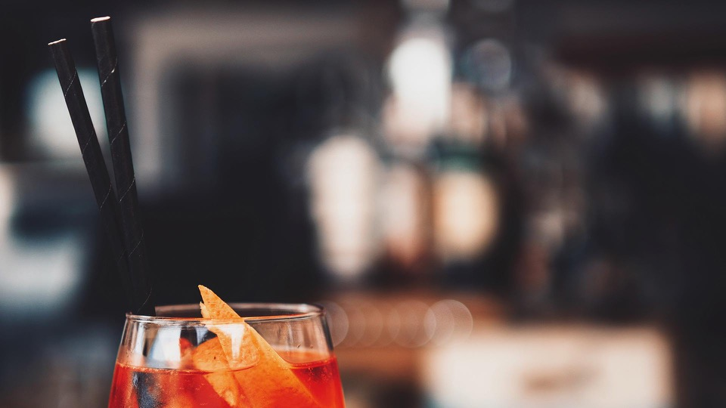
Bôkan Bar & Restaurant NLP Invent Project
Group 6

Slide 2
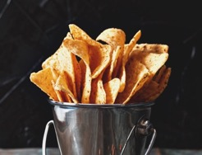
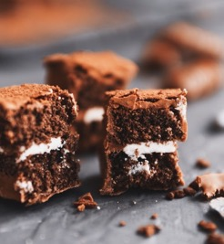
ABOUT THE PROJECT
→ Expansion of Client base
Rebranding of the space based on analysis of data collected
Innovate on the choice of cuisines and the menu
→ Profit Optimization
Revenue Estimation
Cost Estimation
Breakeven Point

Slide 3
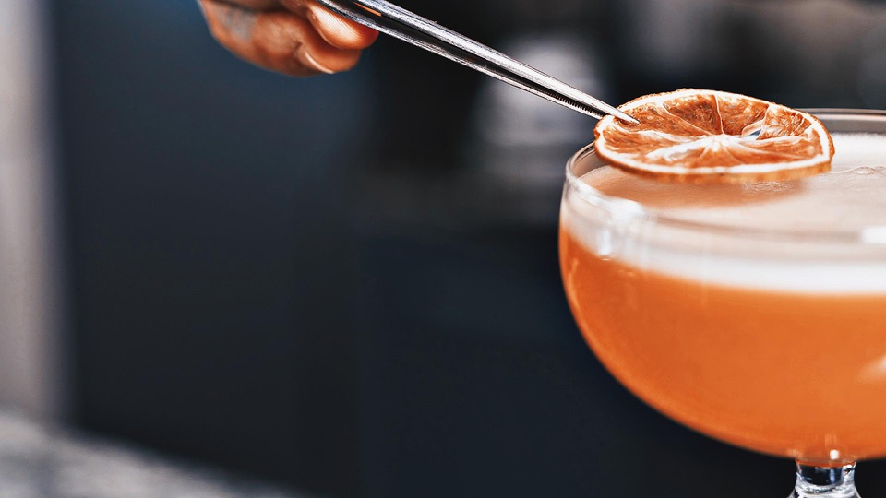



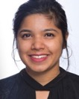
TEAM
TOMMY TRAN
ISMAIL MAJJAD
THOMAS DE MAREUIL
BADR EL-IDRISSI MOKDAD
AKHILA VANGARA

Slide 4
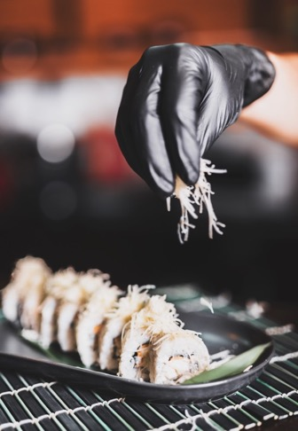
01
CURRENT SITUATION
02
ROADMAP & STATUS REPORT
03
NEXT STEPS
AGENDA

Slide 5
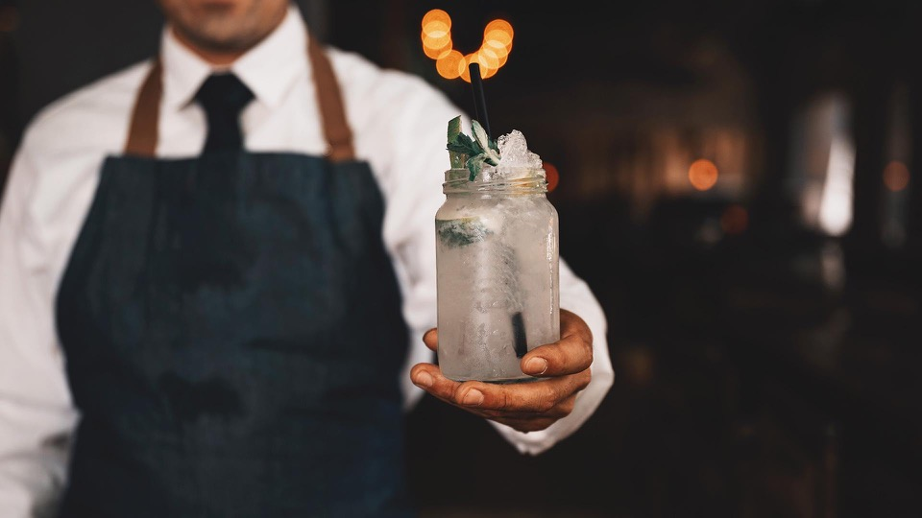
01
CURRENT SITUATION
SWOT analysis
Revenues estimation

Slide 6
BOKAN : A STRATEGIC ANALYSIS
Bar & Restaurant & Rooftop
Above the Novotel HOTEL in Canary WhARF
Weekly events including themed music performances
Bokan is a well-established bar & restaurant that needs to prospect for new types of customers

Slide 7

Strengths
Flexible: As the restaurant was not created toward a certain type of food, the chef is free to change the menus regularly, allowing the restaurant to adapt to current trends an attract more clients
Brand positioning: Award-winning for food & drink. Experienced and renowned French chef Guillaume Gillan in charge of the kitchen.
Location and view: Canary Wharf is the main business district of London, resulting in thousands of potential clients year-round. The restaurant attracts many customers for its breathtaking view.
Well-known and well-placed

Slide 8
Client base: Targets mostly business and hi-budget clients
Access means: The restaurant and the bar are hard to find and access since they are located on the 37th and 38th floor of a hotel.
Weaknesses
A too selective client base

Slide 9
Location: location in Canary Wharf targets business clients, which make for a regular and more predictable client base (business dinners, etc).
Pricing power: business clients tend to be less sensitive to prices (banks, etc.). Location (next to offices) and quality tend to be more important than prices.
Opportunities
Luxury catering is doing well

Slide 10
Threats
Competition from new business: Growing trend over new types of restaurant such as fancy fast-foods and Vegan restaurants.
Competition from existing business: Companies might want to keep it simple and stick with the long-established brands in Canary Wharf when planning business trips.
Slowdown in activity with Brexit: banks moving offices to France or other EU countries might impact hospitality and restauration industries in Canary Wharf.
Increased competition & impact of Brexit

Slide 11




REVENUE ESTIMATION : RESTAURANT
01 BRUNCH
02 DINNER
70 seats 2 services
70 seats 2 services
50% Occupancy rate
80% Occupancy rate
100% Fri/Sat 80% Sun 70% Other
70 people eating
110 people eating
Menu of £52
£45 per person
Menu of £52
£20 per person
£52 per person
£65 per person
£3.700 per brunch
£7.200 per dinner

Slide 12
REVENUE ESTIMATION : BAR/ROOFTOP IN WINTER
01 12h – 15h
02 15h – 19h
01 19h – 00h
50 seats
50 seats
50 seats
20% Occupancy rate
40% Occupancy rate
60% Occupancy rate
£20 per person
£20 per person
£10 per person
£20 per person
£30 per person
£40 per person
£400 per hour
£1.000 per hour
£1.800 per hour
£14.300 per day in winter

Slide 13
REVENUE ESTIMATION : BAR/ROOFTOP IN SUMMER
01 12h – 15h
02 15h – 19h
01 19h – 00h
50 seats
50 seats
50 seats
50% Occupancy rate
80% Occupancy rate
90% Occupancy rate
£20 per person
£20 per person
£10 per person
£20 per person
£30 per person
£40 per person
£1000 per hour
£2000 per hour
£2150 per hour
£21.800 per day in summer

Slide 14
REVENUE ESTIMATION
Restaurant / Brunch
Restaurant / Dinner
Bar & Rooftop / Winter
Bar & Rooftop / Summer
£3.700 per lunch
365 days
1.4 M£ per Year
£7.200 per dinner
365 days
2.6 M£ per Year
£14.300 per lunch
8 months
3.5 M£ per Year
£21.800 per lunch
4 months
2.6 M£ per Year
Total Revenues: 10.1 M£ per Year

Slide 15
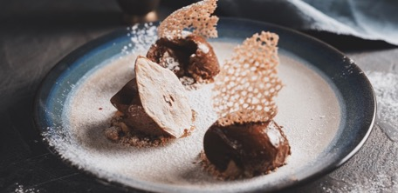
10.1 M£
40%
22 K£
REVENUE ESTIMATION: KEY TAKEAWAYS
Earnings per year
Part of the restaurant in the total earnings
Earnings per day in summer for the bar

Slide 16
02
ROADMAP & STATUS REPORT
Objectives
Model timeline
First AI-based suggestions

Slide 17
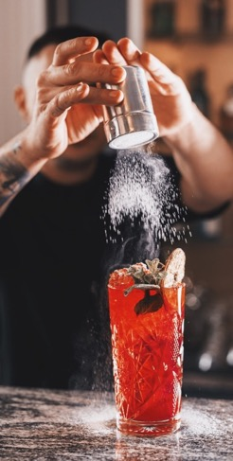
PROJECT OBJECTIVES
01
Build KPIs to help the restaurant management follow the success of the project.
02
Build a Natural Language Processing (NLP) model to analyze reviews on Internet.
03
Use the NLP model to understand the strengths and the weaknesses of the restaurant. Rebrand the restaurant taking into account the KPIs built.

Slide 18

Key Performance Indicators (I)
Sales
Break Even point – Sales volume needed to earn back the amount invested
Gross Profit – Restaurant earnings after subtracting the cost of goods sold
Cash Flow – Total cash that goes in vs what flows out (Cash Input - Cash Output)
Social Media
Engagement – Number of likes, shares, retweets or comments for each post
Reach – Social media audience: number of followers, traffic data, etc.
Customer Feedback
Customer Reviews – reviews on Facebook, TripAdvisor, booking.com, etc.
Overall Customer Satisfaction (CSAT) – CSAT scores are based on surveys where customers rate satisfaction from 1 to 7 (positive responses start at 5).
Time per table turn and table turnover rate (TTR: Nb of Guests Served / Nb of Tables) - to provide adequate wait times (impacting CSAT) and maximize revenue.
Customer Retention Rate (%) = (# of Customers at End of Period - # of Customers for That Period) / (# of Customers at Beginning of Period). A 5% increase in customer retention can lead to up to 90% increase in profits (Harvard, 2012).

Slide 19
Key Performance Indicators (II)
Employee Engagement KPIs
Employee Turnover – Hiring and training new employees is costly, thus it’s important to define an “acceptable” level of turnover (taking into account the high average turnover rates in London). Employee retention can be improved by valuing employee feedback and dialogue.
Employee Satisfaction (ESAT) – Score measured through team meetings and surveys. Companies with high ESAT rate tend to outperform competitors.
Sales per labour hour (SPLH: Total sales / total # of worked hours) – SPLH is a measure of employee performance, with target sales per hour scheduled.
Kitchen and front house management
Revenue per available seat hour (RevPash = Total revenue / [available seats x opening hours]). RevPASH is used to optimize labor scheduling, plan food purchasing, and to improve table turn times.
Food and beverage sales per guest – Allows to understand if menu needs to be restructured based on favorites of the customers or time of the day.
Menu Item profit and popularity – Such measures allow for strategic pricing of items on the menu, to drive sales and make decisions for promotions / discounts.

Slide 20
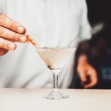
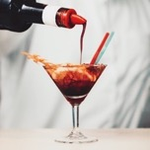
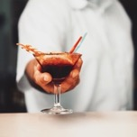



NLP MODEL TIMELINE
01
02
03
Collect and clean Data
Focus on Word Embedding and Topic Extraction
Build a Sentiment Analysis model

Slide 21
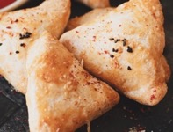
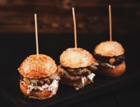
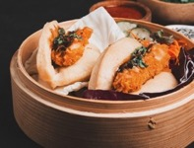
DATA COLLECTION & DATA CLEANING
STEP
01
Web Scrapping
Tokenization
Lemmatization
Collect as many reviews on the Internet as possible (several thousands)
Break a stream of text into words, phrases, or other meaningful elements called tokens
Reduce inflection in words to their root forms ensuring that the root word belongs to the language

Slide 22


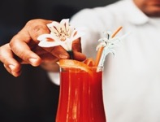
WORD EMBEDDING
STEP
02
Embedding
LSI
Word2Vec
Representation in which a word is associated to a numeric vector. We can then perform calculations and operations on embedding matrices
Mathematical method for modeling the meaning of words and passages by analysing a corpus of texts
Embedding method which embark a neural net with context and target word notions

Slide 23
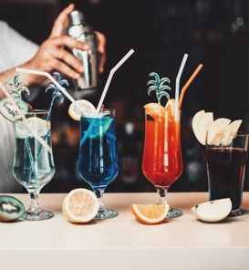
FIRST SUGGESTIONS
Correct current flaws of the restaurant
2 leverages to increase profit: Augment Sales…
…Or: Contain Costs
Adjust positioning based on competition
QUALITATIVE
QUANTITATIVE
Based on technical analysis of comments, which isn’t complete yet, we’ll be able to identify the main pain points for customers of Bokan 37, so that the restaurant can tackle these issues.
For Sales, Bokan 37 can:
Reach more customers (OR): leverage hotel resources, increase marketing
Increase average spending: adjust prices based on competition/comments.
Key aspects are elasticity of customers (i.e. rev) to price and indirect impact of rev optimization (costs, hotel brand image)
On a larger scale, we’ll also be able to provide qualitative insight so as what positioning (type of cuisine, type of atmosphere) works best in Canary Wharf or doesn’t exist yet (to differentiate).
For costs, Bokan 37 should make efforts to contain:
Fixed costs: optimize overhead costs
Variable costs: workforce costs and purchase of food and drinks should be optimized as well – keeping in mind the impact on quality.
For this, we would need more financial information (P&L, CF statement, etc.).

Slide 24
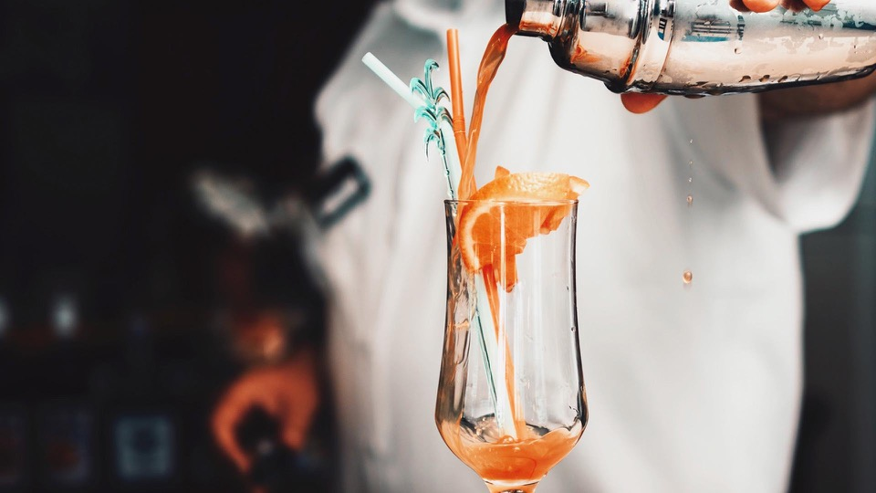

03
NEXT STEPS
Next deadlines
Ideas to be further explored

Slide 25
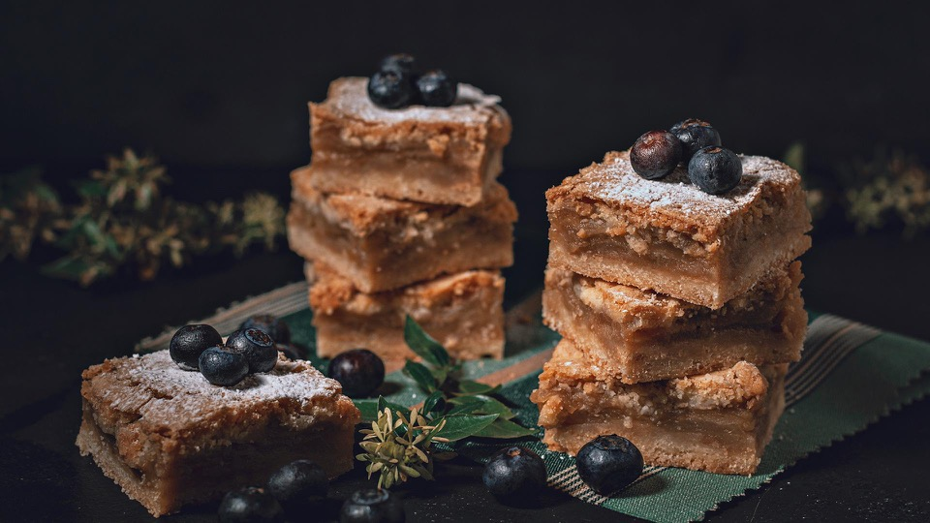
+20%
OUR GOAL
in profits, at a 2-year horizon

Slide 26
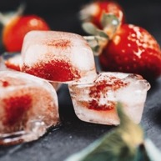

WHERE WE ARE
WHERE WE WANT TO BE
Our current estimates:
Sales: 10.1 £M
OR: between 20% and 80% depending on hour
Conservative average spending estimate
Costs still to be optimized
Quick and efficient transformation measures to boost profits:
Sales: ≈ 12 M£ (+19%), through revenue optimization measures and +10ppt OR on average
Costs: increased marketing spending but overall optimization, to reach +20% profits at a 2-year horizon

Slide 27
OUR NEXT STEPS
Workstreams
AI-analysis
Financial analysis
Qualitative recommendations
Quantitative recommendations
Finalize:
STEP
02
Embedding
STEP
03
Sentiment analysis
Project advancement
50%

Slide 28
PROJECT SCHEDULE
FEBRUARY
MARCH
Overall project
An efficient
NLP
AI analysis
model
Financial analysis
+20%
Qualitative rec.
in profits (2y)
Quantitative rec.

Slide 29
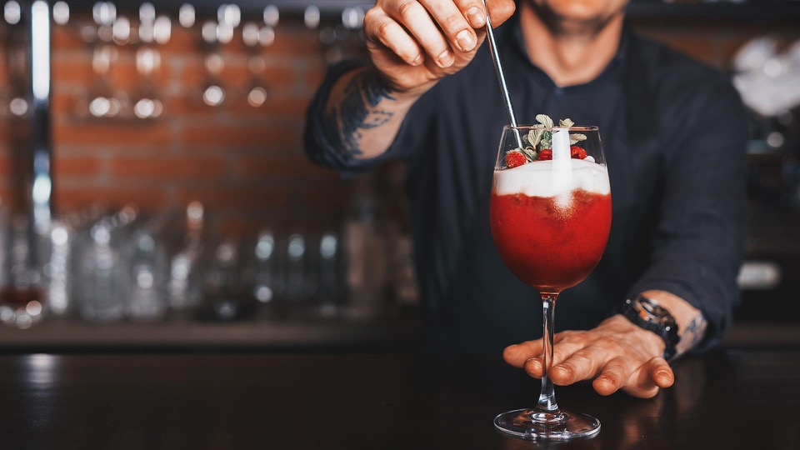
MANY THANKS FOR YOUR ATTENTION

